Slide 1


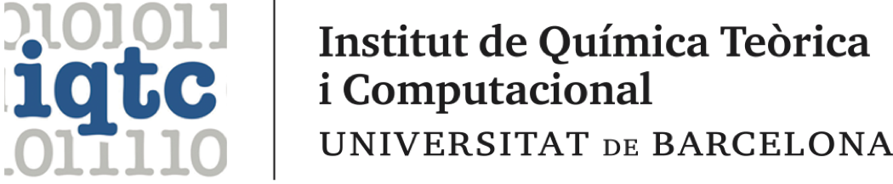

Investigating the Excited State Properties of Photoactive TiO₂ Nanoclusters through Non-Adiabatic Molecular Dynamics
Miguel Recio-Poo, Francesc Illas, Stefan T. Bromley, Alexey V. Akimov, Ángel Morales-García
Departament de Ciència de Materials i Química Física
Institut de Química Teòrica i Computacional (IQTCUB)
Universitat de Barcelona
miguelrecio@ub.edu

Slide 2
OUTLINE
Motivation and previous research
Methodology - Libra/CP2K workflow
First project: role of water and benchmark analysis
Second project: recombination or relaxation in small bare NPs
Conclusions
Miguel Recio Poo
LIBRA Summer School 2024
2/30

Slide 3
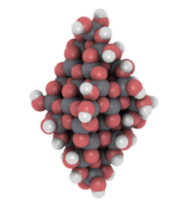
Water splitting: a simple idea
H₂
O₂
H₂O H₂ + ½ O₂
Energy
H₂O
Chemical energy
𝚫G⁰= 237 kJ/mol
TiO₂
Clean energy production but against thermodynamics
Need of external energy -> photocatalytic water splitting
Anatase titania (TiO₂) nanoparticles potential solution
BG is too large. Absorbs only a small fraction of solar spectrum.
It is inert enough, and can be functionalized -> DSSC
Miguel Recio Poo
LIBRA Summer School 2024
3/30

Slide 4
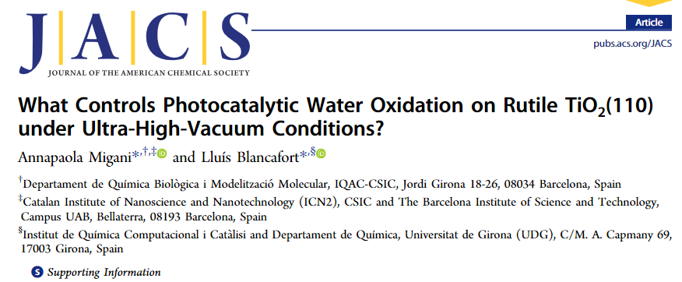

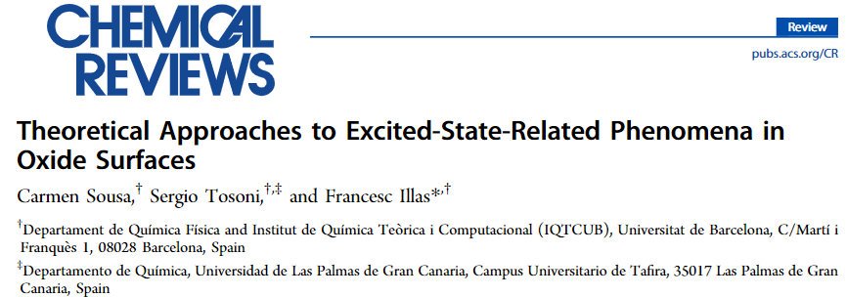
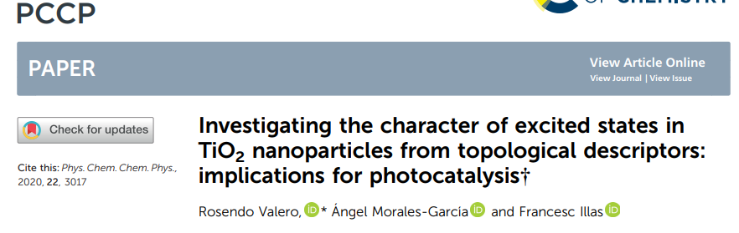
Previous research
Previous studies based on time-domain version of the Kohn-Sham DFT (KS-DFT):
A single-particle treatment inadequate for quantitative characterization of the dynamics in systems as TiO₂ nanostructures. More rigorous (linear-response, LR) time-dependent DFT (TD-DFT) framework needed.
Miguel Recio Poo
LIBRA Summer School 2024
4/30

Slide 5
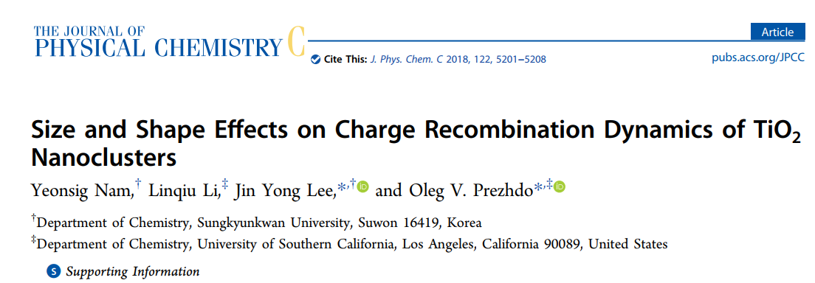
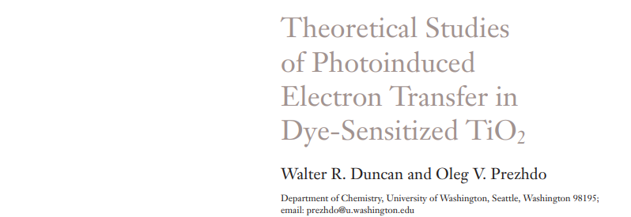
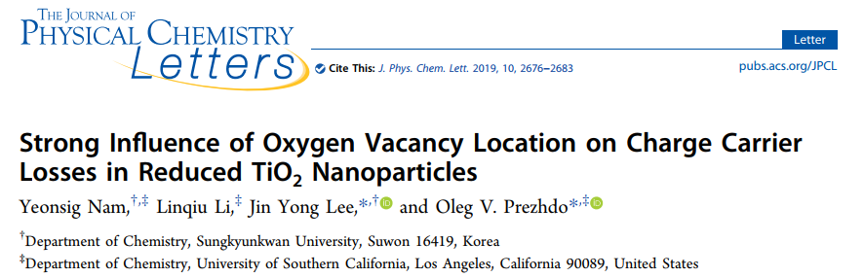
Previous research
Non-Adiabatic Molecular NA-MD trusted as the suited technique to investigate the dynamics of excited states
Lack of research concerning the influence of water on photoactive nanostructures when adsorbed in their surfaces
Miguel Recio Poo
LIBRA Summer School 2024
5/30

Slide 6
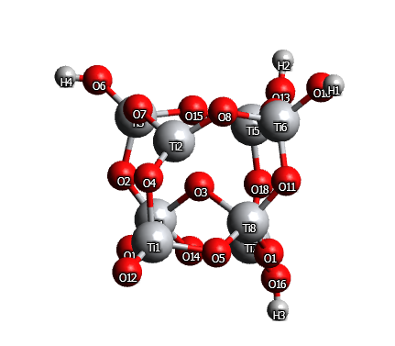
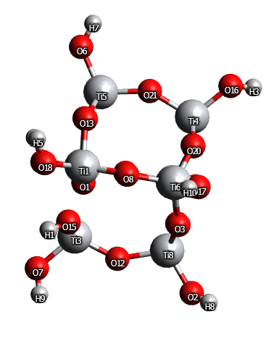
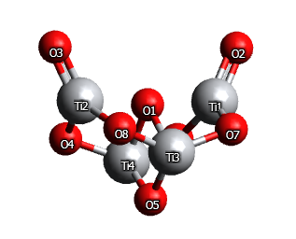
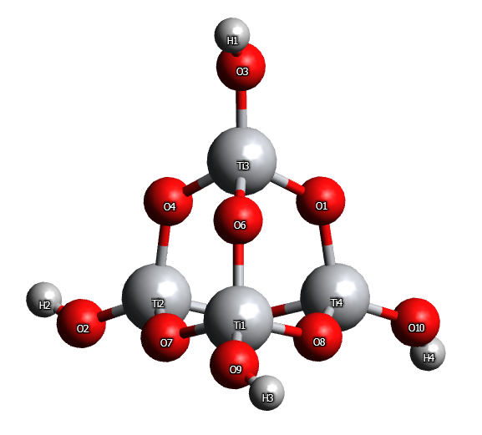
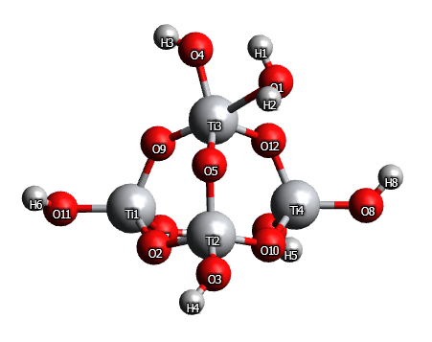
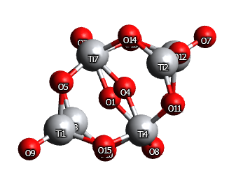
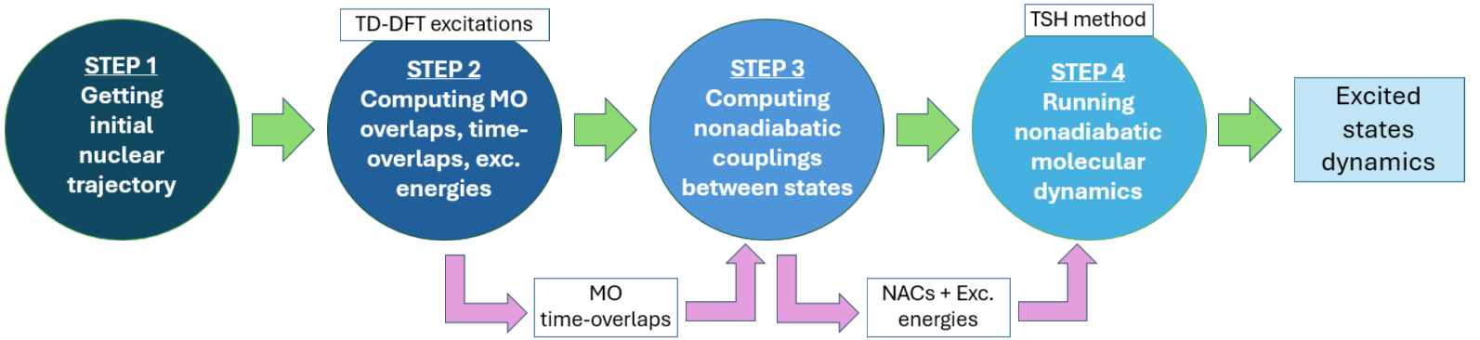
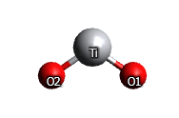
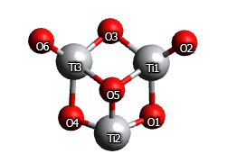
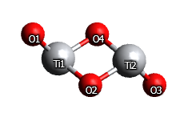
Methodology - Libra/CP2K workflow
CP2K: step 1, step 2 (excitations)
Libra: step 2 (overlaps), step 3, step 4
Miguel Recio Poo
LIBRA Summer School 2024
6/30

Slide 7
First project: water effect and benchmark analysis
(TiO₂)₄
(TiO₂)₄(H₂O)₂
(TiO₂)₄(H₂O)₄
(TiO₂)₈
(TiO₂)₈(H₂O)₂
(TiO₂)₈(H₂O)₅
Benchmark the used TD-DFT and NA-MD methodologies for their further applications to bigger photoactive nanostructures
Investigate the dependence of static excited state properties and excited state dynamics on the nanocluster size and hydration degree.
Miguel Recio Poo
LIBRA Summer School 2024
7/30

Slide 8
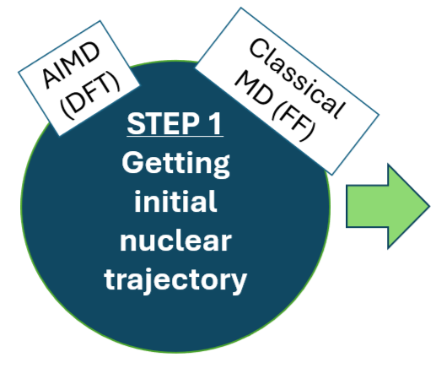
First project: water effect and benchmark analysis
GULP: Classical MD (NanoTiO & FFTiOH IP)
CP2K: AIMD (PBE), xTB
NVT ensemble. Target temperature: 300 K
4 ps run (1 ps equilibration + 3 ps production)
1 fs timestep → 3000 different geometries
Miguel Recio Poo
LIBRA Summer School 2024
8/30

Slide 9
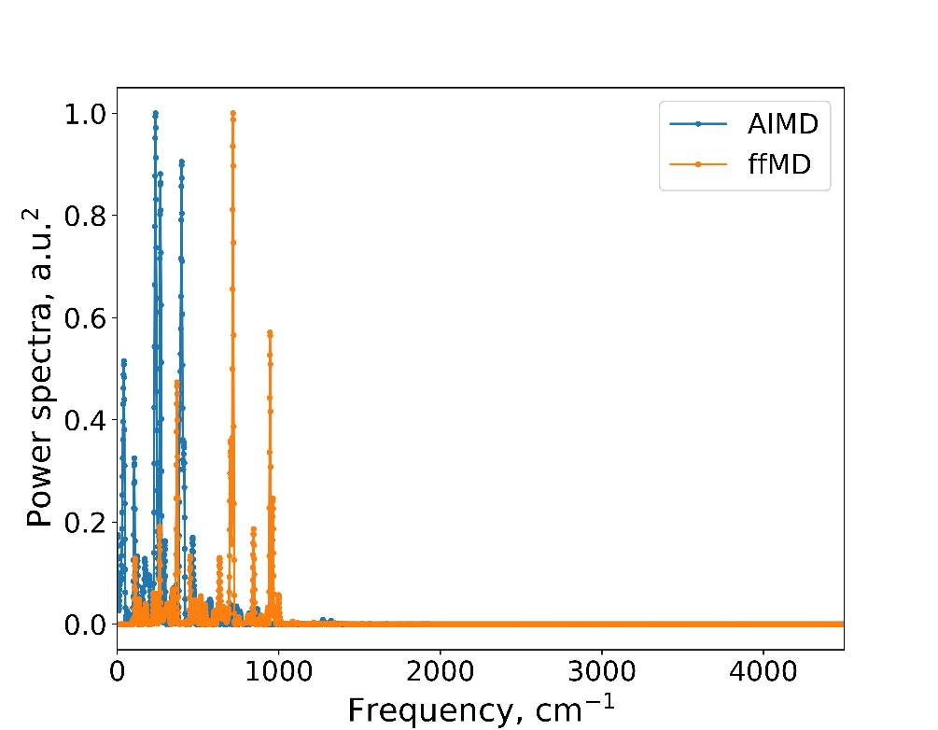
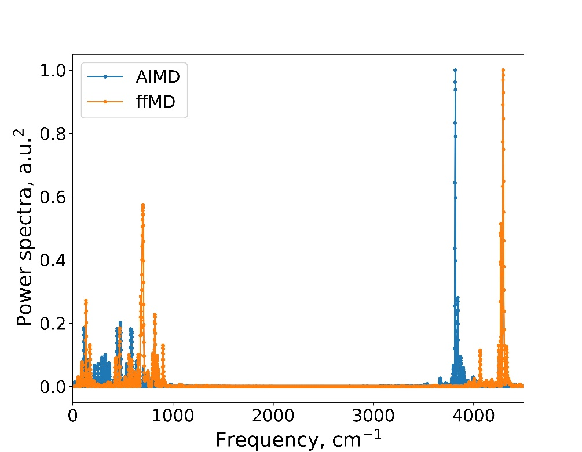
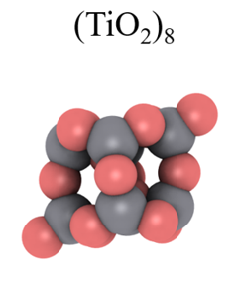
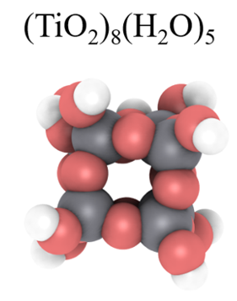
First project (step I)
The atomic vibrational frequencies of our titania clusters along the 3000 fs runs let us easily compare the performance of either methodology.
Vib. modes at frequencies similar to those observed in titania bulk phase
100 to 200 cm⁻¹ -> Ti-O stretching modes 500-1000 cm⁻¹ -> Ti-O-Ti angle bending
Hydrated (TiO₂)₈ clusters: characteristic hydroxyl stretching mode around 3700-3900 cm⁻¹ values²
Miguel Recio Poo
LIBRA Summer School 2024
9/30

Slide 10
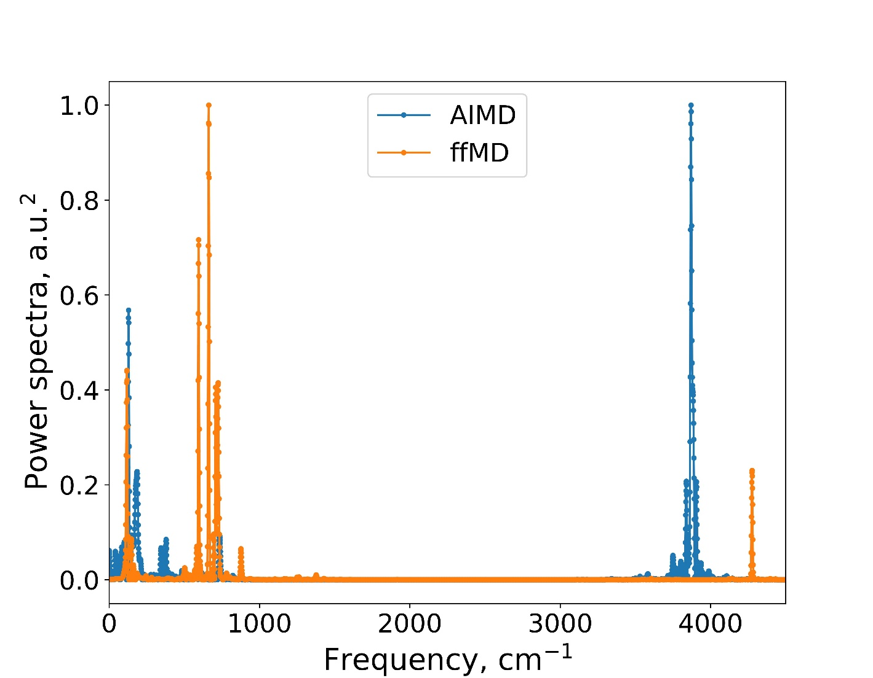
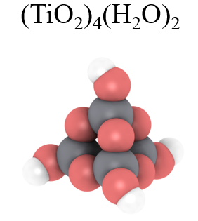
First project (step I)
Anharmonic effects in AIMD approach -> lower frequency values but also busier vibrational densities
Power spectra are qualitatively the same -> tested FFs are accurate to act as computationally-efficient counterparts to DFT calculations
Miguel Recio Poo
LIBRA Summer School 2024
10/30

Slide 11
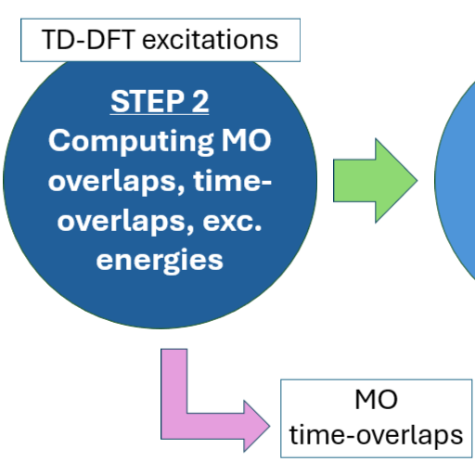
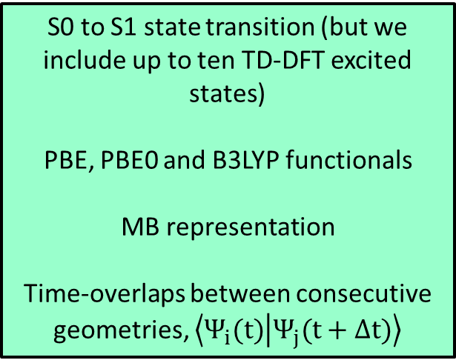
First project (step II)
S0 to S1 state transition (but we include up to ten TD-DFT excited states)
PBE, PBE0 and B3LYP functionals
MB representation
Time-overlaps between consecutive geometries, $\left\langle Ψ_{i}(t) | Ψ_{j}(t+Δt)\right\rangle$
Miguel Recio Poo
LIBRA Summer School 2024
11/30

Slide 12
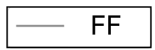
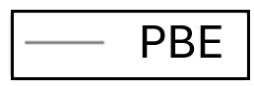
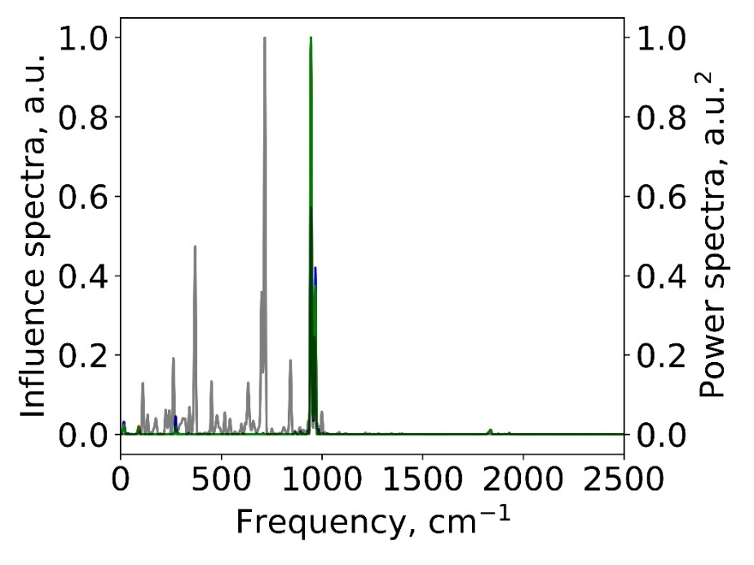
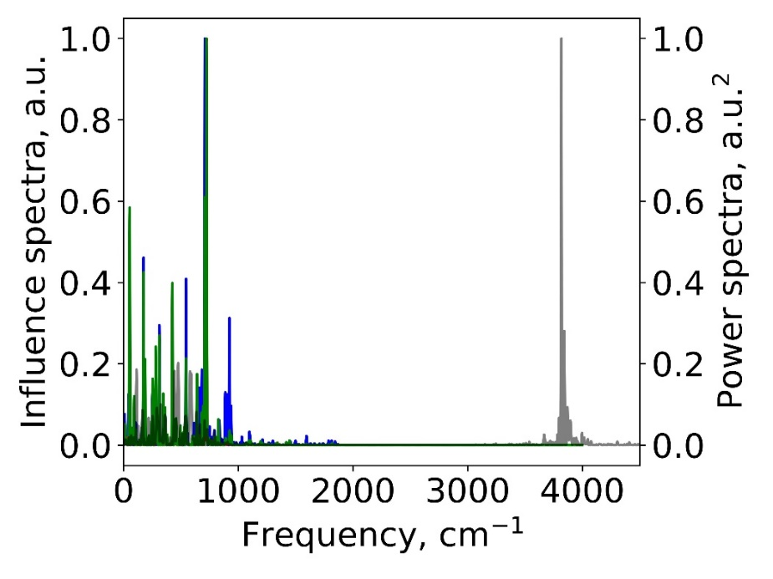
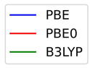
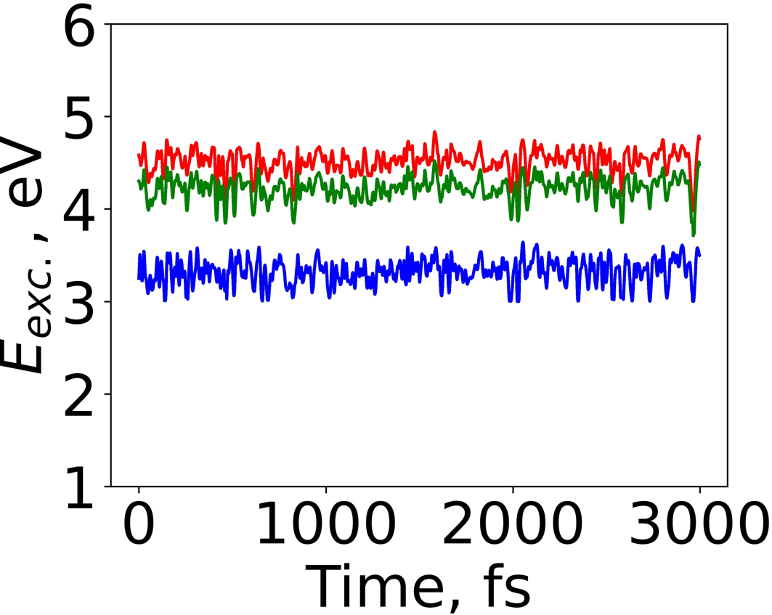
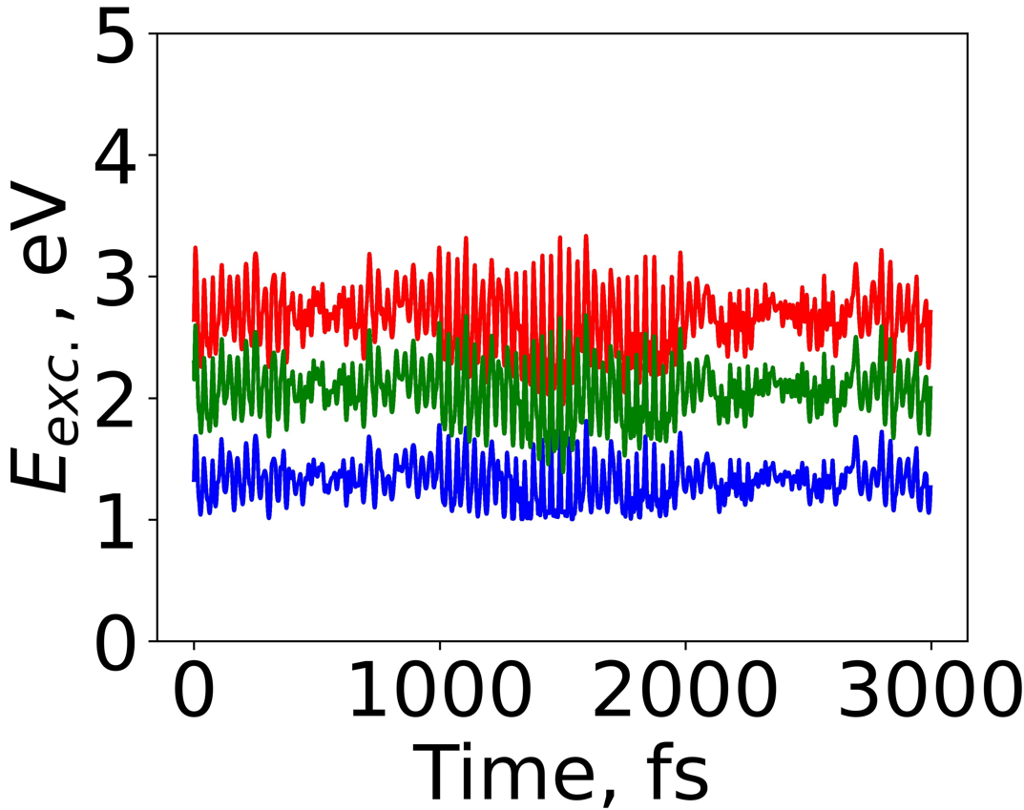
First project (step II)
FT of δE_{ij} gives rise to the influence spectra, which shows up the vibrational modes responsible for S0 to S1 transition
(TiO₂)₈(H₂O)₀
(TiO₂)₈(H₂O)₅
Bare case: S₁→S₀ transition is driven by the Ti-O-Ti angle bending mode
Hydrated clusters: driven by bending and stretching modes
Hydroxyl related modes not coupled to the S₁→S₀ transition
Miguel Recio Poo
LIBRA Summer School 2024
12/30

Slide 13
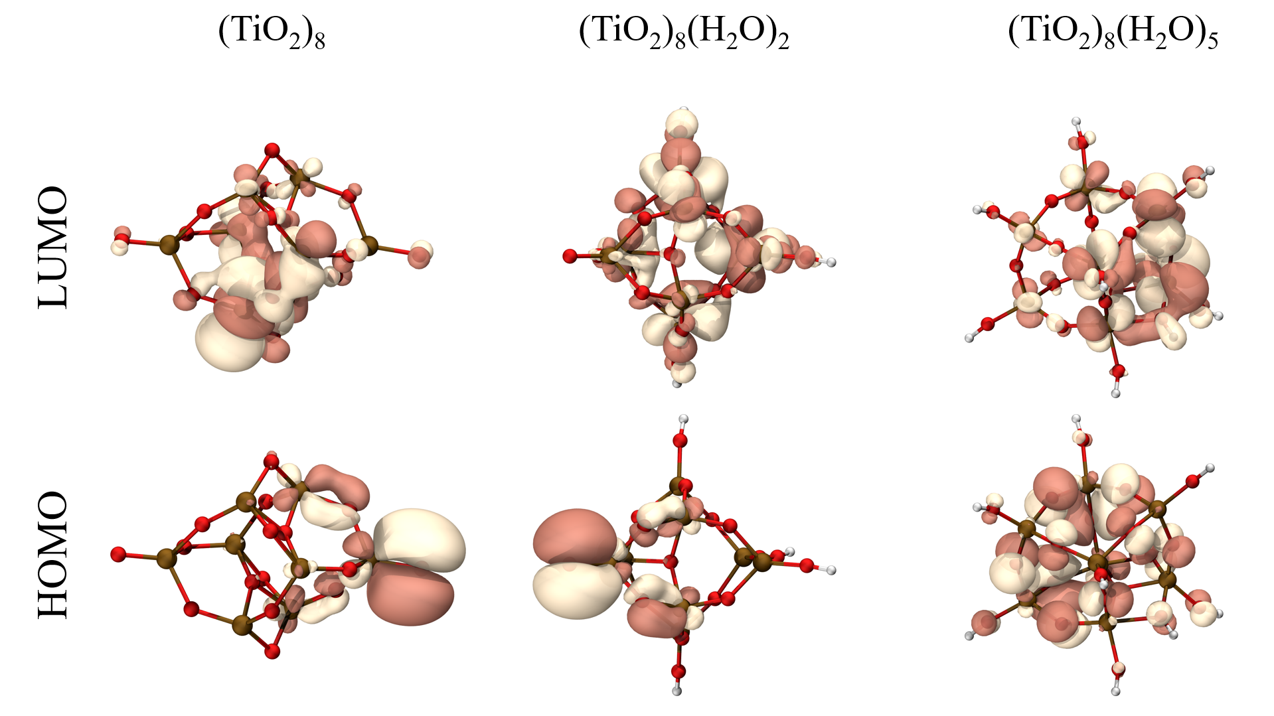
First project (step II)
Larger electronic densities located around the Ti-O bonds. Consistent with the spectra.
Excited state of bare shows larger transition dipole moment. Increasing degree of hydration -> excited state becomes more symmetric, leading to smaller TDM
Miguel Recio Poo
LIBRA Summer School 2024
13/30

Slide 14
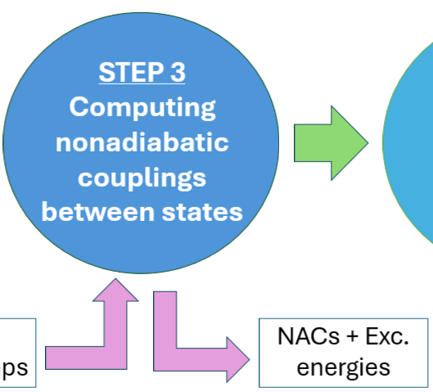
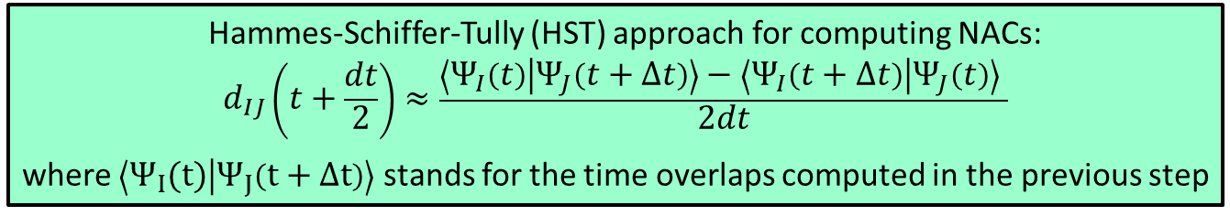
First project (step III)
Hammes-Schiffer-Tully (HST) approach for computing NACs:
$$d_{IJ}\left(t+\frac{dt}{2}\right)≈\frac{\left\langle Ψ_{I}\left(t\right) | Ψ_{J}\left(t+Δt\right)\right\rangle −\left\langle Ψ_{I}\left(t+Δt\right) | Ψ_{J}\left(t\right)\right\rangle }{2dt}$$
where $\left\langle Ψ_{I}(t) | Ψ_{J}\left(t+Δt\right)\right\rangle$ stands for the time overlaps computed in the previous step
Miguel Recio Poo
LIBRA Summer School 2024
14/30

Slide 15
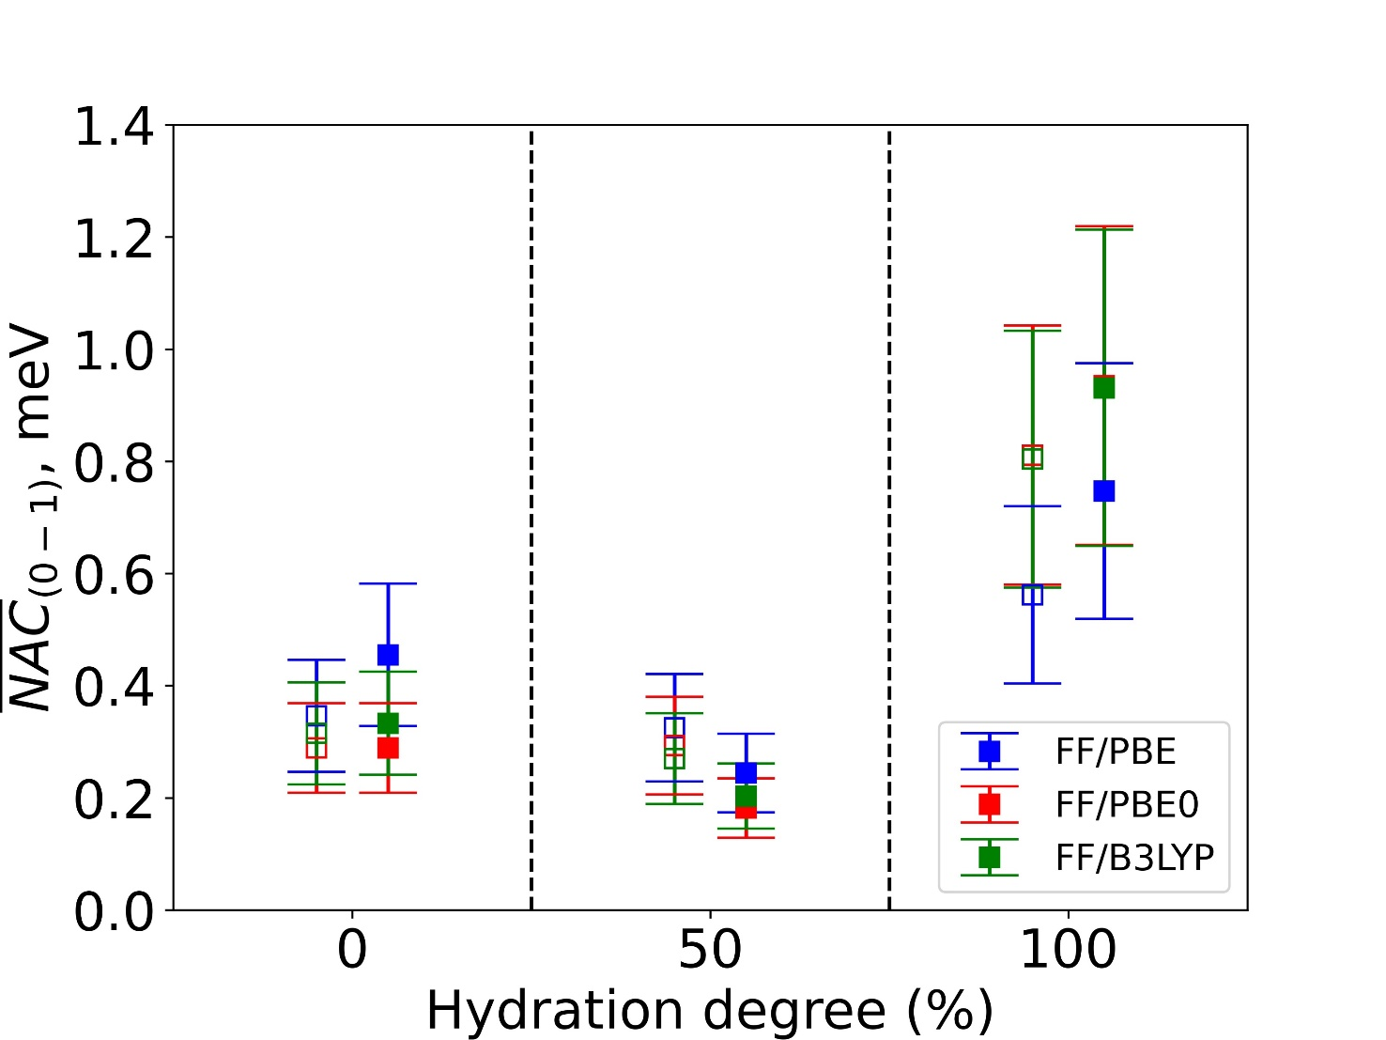
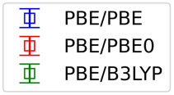
First project (step III)
(TiO₂)₈(H₂O)₀
(TiO₂)₈(H₂O)₂
(TiO₂)₈(H₂O)₅
(TiO₂)₈(H₂O)₂ presents lower average NACs than bare case (states more separated in energy)
For largest degree: the states acquire similar spatial distributions
Fully hydroxylated system possess better electronic state mixing and thus larger NACs
Miguel Recio Poo
LIBRA Summer School 2024
15/30

Slide 16
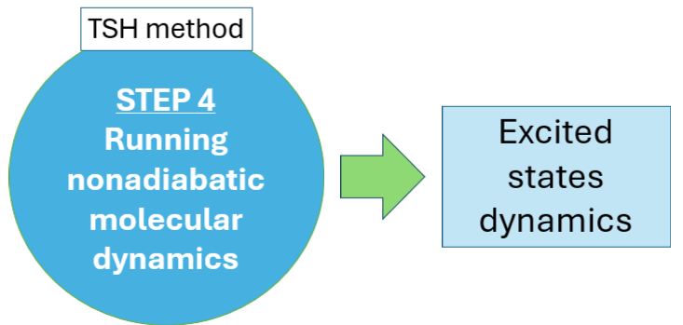
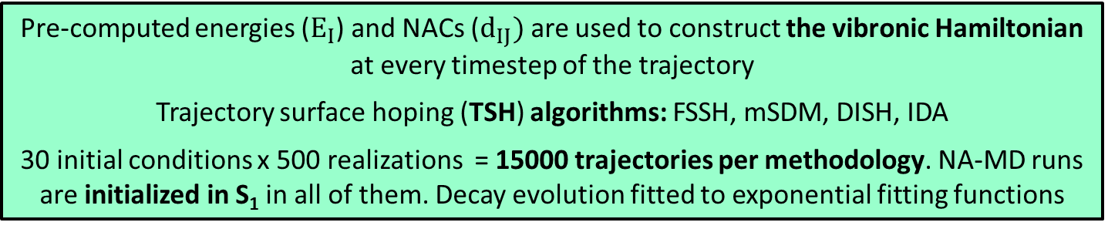
First project (step IV)
Pre-computed energies ($E_{I}$) and NACs ($d_{IJ})$are used to construct the vibronic Hamiltonian at every timestep of the trajectory
Trajectory surface hoping (TSH) algorithms: FSSH, mSDM, DISH, IDA
30 initial conditions x 500 realizations = 15000 trajectories per methodology. NA-MD runs are initialized in S₁ in all of them. Decay evolution fitted to exponential fitting functions
Miguel Recio Poo
LIBRA Summer School 2024
16/30

Slide 17
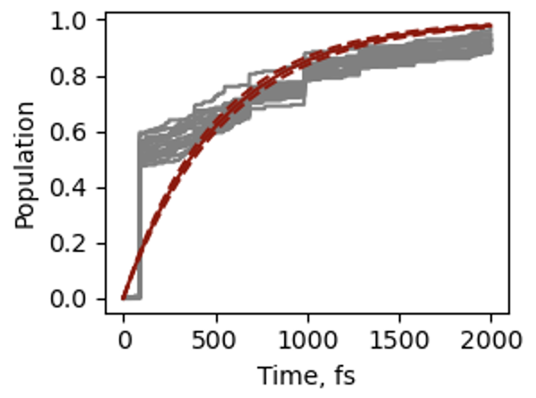
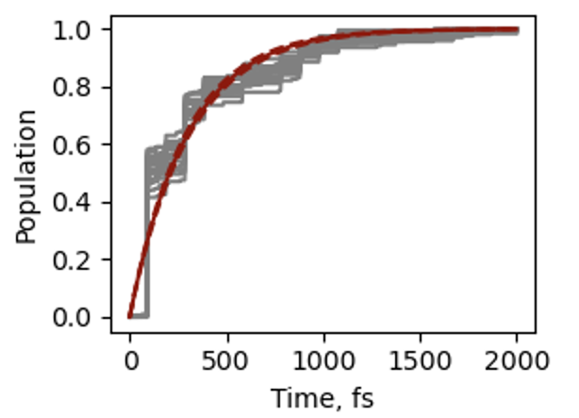
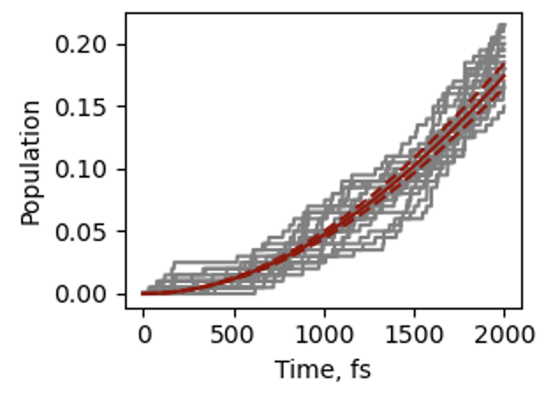
First project (step IV-problematics)
(TiO₂)₄ (H₂O)₄ AIMD + B3LYP
Files: 1500-1800
Files: 1500-1600
Files: 2000-3000
Files: 500-800
✅
We can play with which NACs and excitation energies we select and avoid the problematic step causing the sudden population change
Method: FSSH, ntraj: 200
Miguel Recio Poo
LIBRA Summer School 2024
17/30

Slide 18
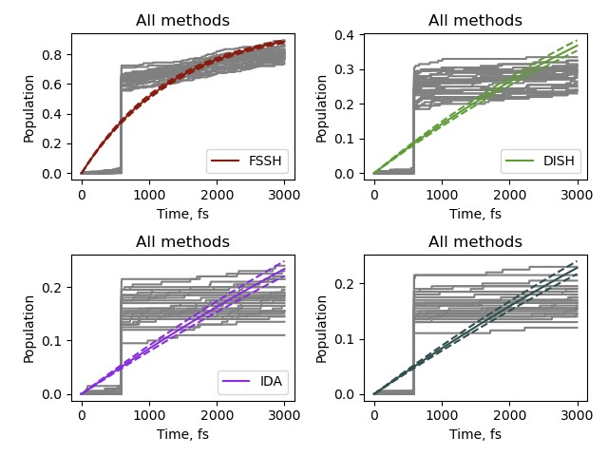
First project (step IV-problematics)
(TiO₂)₄ (H₂O)₄ AIMD + B3LYP
If we include 5 states in our dynamical basis… we have these sudden changes in Ground State population evolution
Method: FSSH, ntraj: 200, files: 1000-4000, steps: 3000
Miguel Recio Poo
LIBRA Summer School 2024
18/30

Slide 19
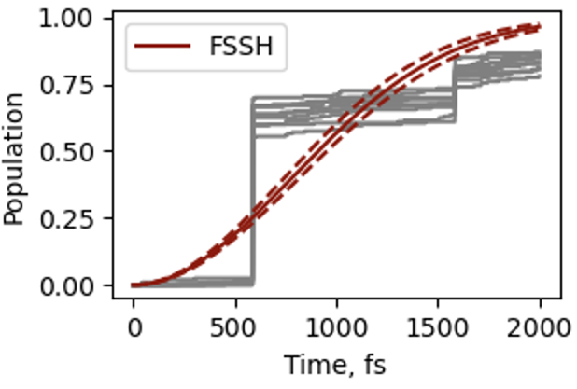
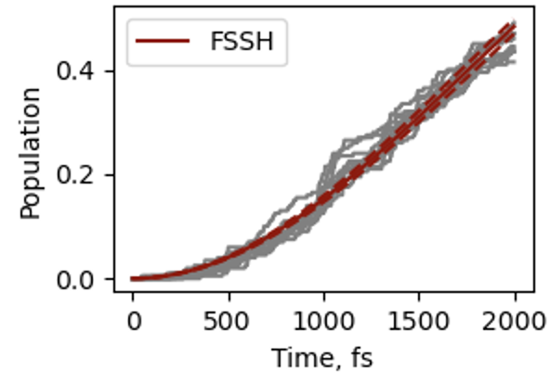
First project (step IV-problematics)
(TiO₂)₄ (H₂O)₄ AIMD + B3LYP
By increasing the number of excited states in our dynamical basis -avoiding crosses with states that are not included in the basis- we can overcome our problem with the sudden changes in states pop. evolution
NSTATES = 5
NSTATES = 10
Method: FSSH, ntraj: 200, files: 1000-2000, nsteps: 2000
Miguel Recio Poo
LIBRA Summer School 2024
19/30

Slide 20
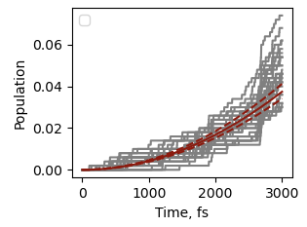
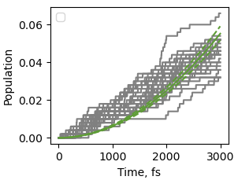
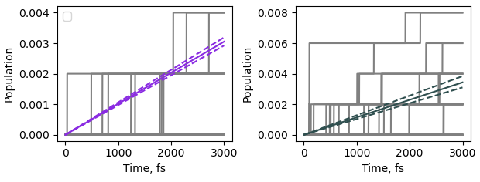







First project (step IV)
FSSH
DISH
MSDM
ID-A
(TiO₂)₄
AIMD + PBE
(TiO₂)₄(H₂O)₂
(TiO₂)₄(H₂O)₄
In all cases FSSH yields shorter e⁻-h⁺recombination times
Faster recombination evolution with increasing degree of hydroxylation
Miguel Recio Poo
LIBRA Summer School 2024
20/30

Slide 21


First project (step IV)
mSDM method involves a complex description leading to the elimination of coherences and thus to larger decay
Hybrid TD-DFT functionals give rise to faster S₁-S₀ recombination
Good agreement in final results between ffMD and AIMD!!
(TiO₂)₈(H₂O)₂ provides longer times – more convenient for photocatalysis
Miguel Recio Poo
LIBRA Summer School 2024
21/30

Slide 22


Second project: recombination or relaxation?
sub-picosecond excited state lifetime (τ) is attributed to rapid internal conversion returning to the ground state.
Miguel Recio Poo
LIBRA Summer School 2024
22/30

Slide 23


Second project: Wigner sampling
RUN GEOMETRY OPTIMIZATION WITH CP2K
+ CALCULATION OF VIBRATIONAL FREQUENCIES
10 GEOMETRIES + VELOCITIES:
RUN STEP1, STEP2 (CAM-B3LYP), STEP3, STEP4
TiO₂_01-VIBRATIONS-1.mol
RUN wigner.py SCRIPT
(-n 100) (-t 300)
initconds file
COMPUTE AVERAGE VALUES
Miguel Recio Poo
LIBRA Summer School 2024
23/30

Slide 24



Second project
Average timescale: 26.34+-7.94 ps
Average timescale: 915.95+-64.22 ps
Several orders of magnitude bigger than the experimental times
Miguel Recio Poo
LIBRA Summer School 2024
24/30

Slide 25



Second project
Average timescale: 5.00+-2.08 ps
Average timescale: 33.67+-14.65 ps
Several orders of magnitude bigger than the experimental times
Miguel Recio Poo
LIBRA Summer School 2024
25/30

Slide 26




Second project: trajectory aligment
Average timescale: 17.89+-1.09 ps
Average timescale: 41.56+-5.64 ps
Miguel Recio Poo
LIBRA Summer School 2024
26/30

Slide 27




Second project: Oscillator Strength TiO₂
Miguel Recio Poo
LIBRA Summer School 2024
27/30

Slide 28

Second project: TiO₂
✅
Miguel Recio Poo
LIBRA Summer School 2024
28/30

Slide 29
5. Conclusions
ESPA Tarragona 2024
Conclusions
Libra (interchanged with CP2K) provides a complete workflow to analyse excited state dynamics in titania systems.
Influence of water in general reduce recombination times, as NACs increase. Methodology assessment: ffMD is efficient counterpart to AIMD. Hybrid functionals give rise to faster S₁-S₀ recombination.
Small anhydrous calster undergo fast relaxation among optical levels that has been overlooked in experimental research.
Miguel Recio Poo
LIBRA Summer School 2024
29/30

Slide 30










ACKNOWLEDGMENTS
Alexey V. Akimov
Stefan T. Bromley
Ángel Morales García
Francesc Illas
Miguel Recio Poo
LIBRA Summer School 2024
30/30

